Slide 1
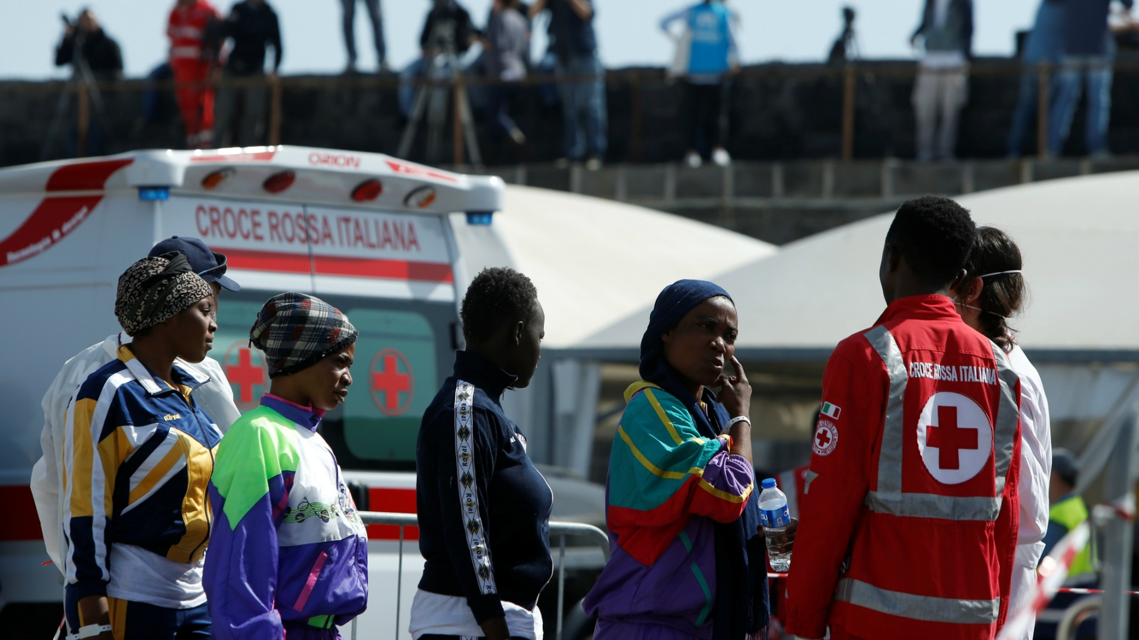



ANALYSIS OF FORCED DISPLACEMENTS IN AFRICA (2002-2017)
UNDERSTANDING THE MAIN FACTORS OF FORCED DISPLACEMENTS

Slide 2
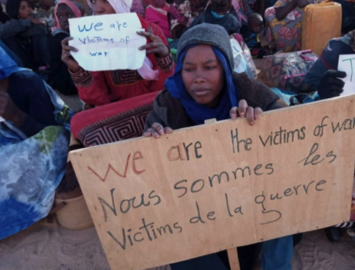
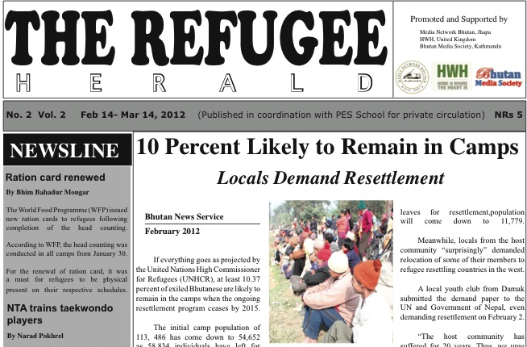
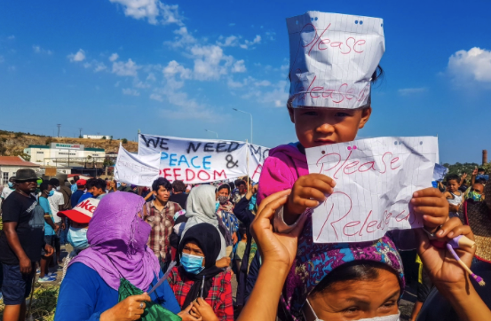
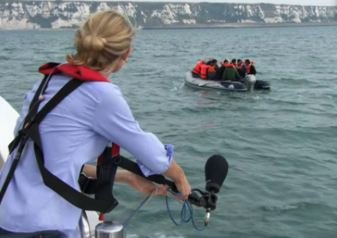

Slide 3
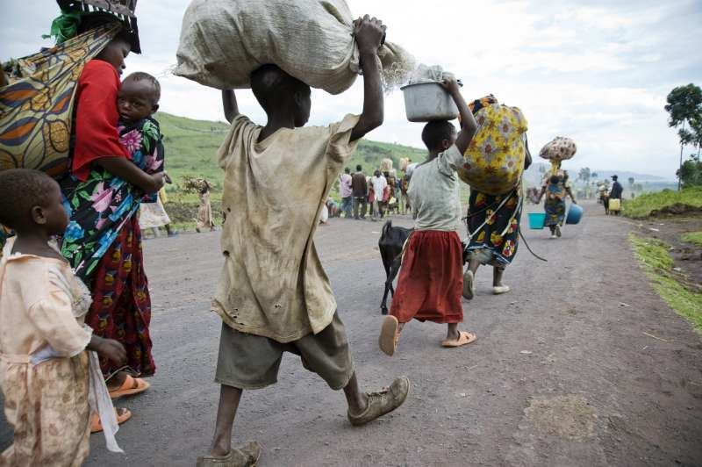
24 % of the Total Refugees are coming from Africa
What is happening in Africa?

Slide 4
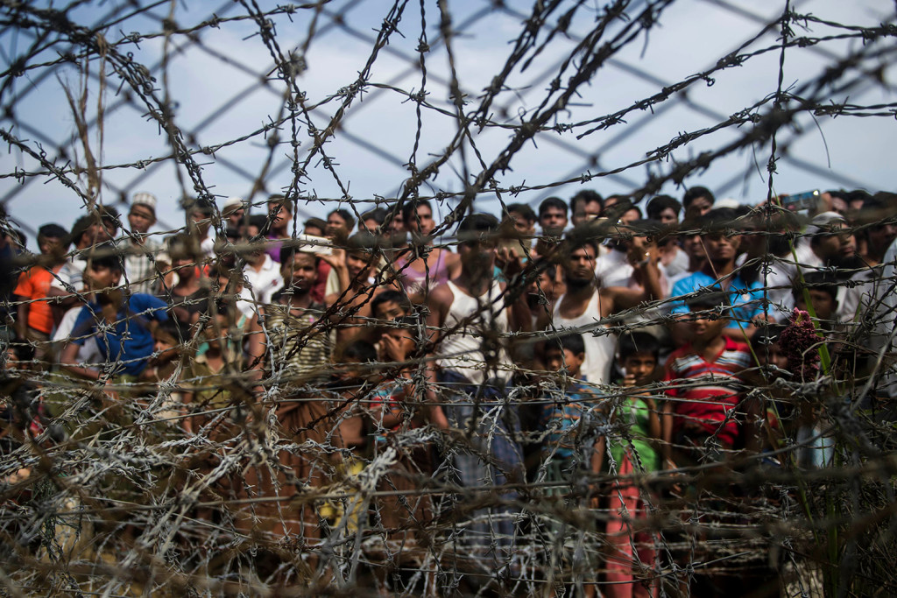


INTRODUCTION
Data | Source
Water Coverage
Sanitation Coverage
Refugees
Asylum Applications
Form of Government, Control of Corruption, Rule of Law, Voice and Accountability, Regulatory Quality, Governance, Political Stability and Absence of Violence
Intestinal Deaths
AIDs Deaths

Slide 5
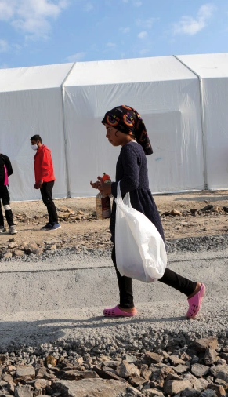
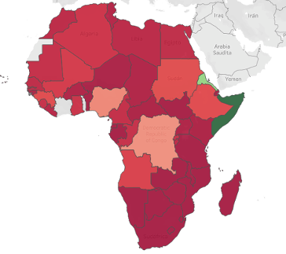
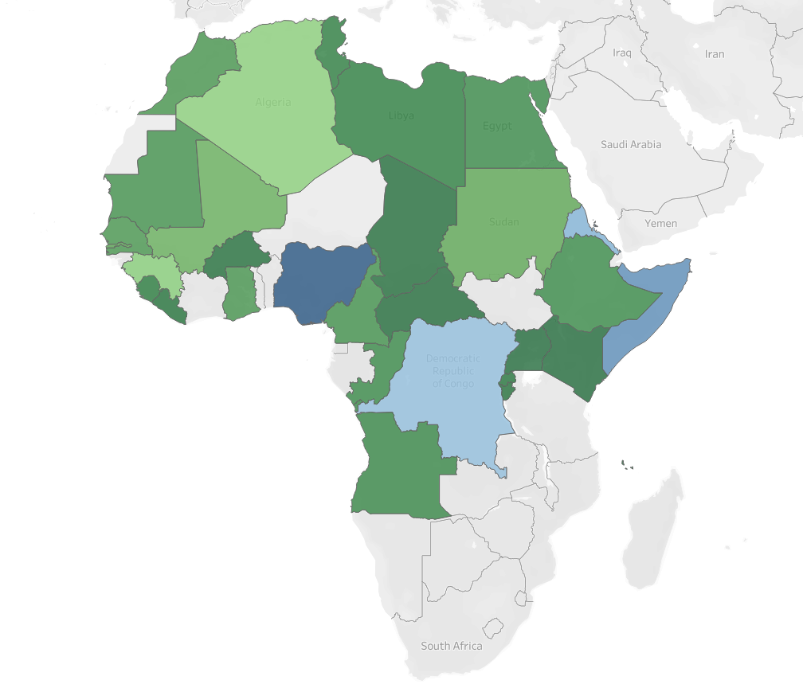
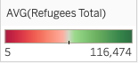
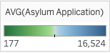
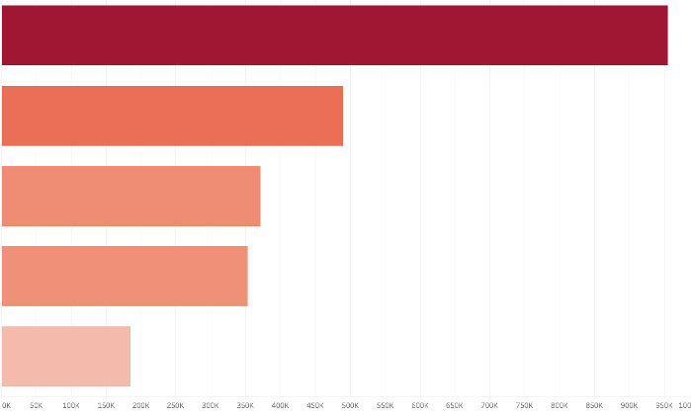
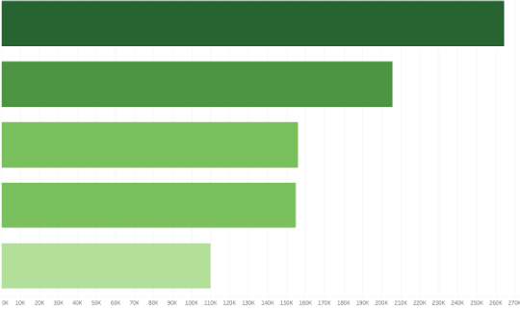
Average Number of Refugees per Country
Average Number of Asylum Applications per Country
Top 5 Countries (number of refugees)
Top 5 Countries (number of asylum seekers)
Somalia
Nigeria
Eritrea
Somalia
Dem.
Rep.Congo
Eritrea
Dem.
Rep.Congo
Nigeria
Sudan
Algeria

Slide 6
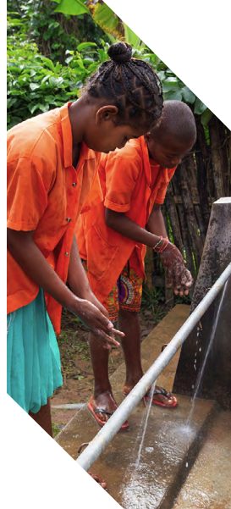
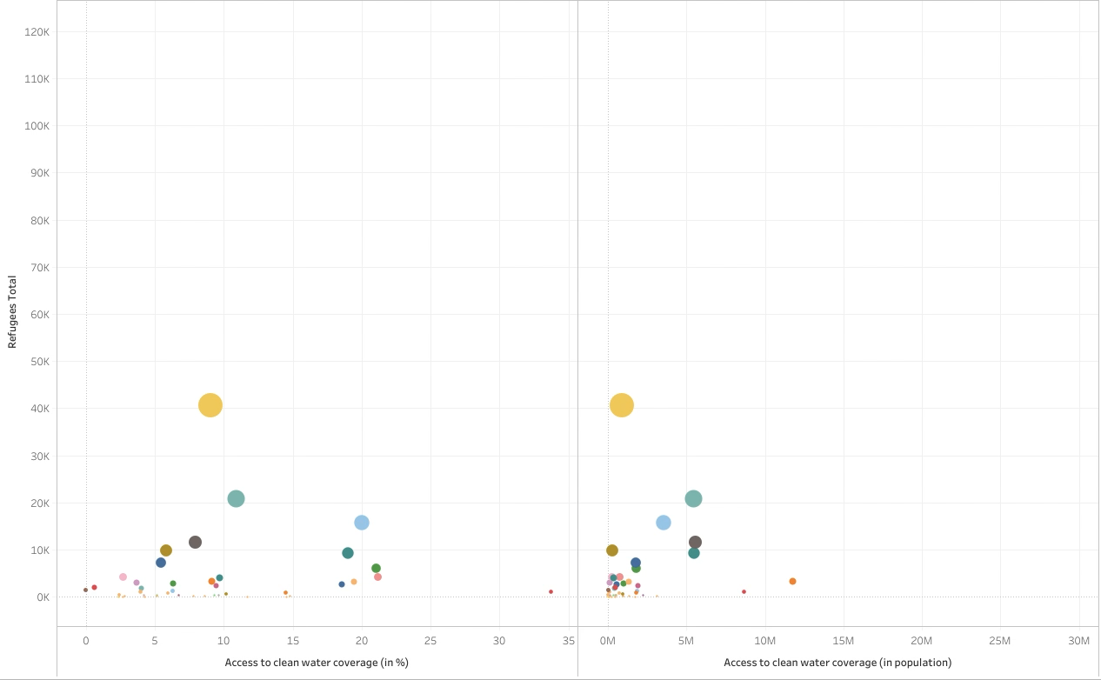
Limited Service
Drinking water from an improved source for which collection time exceeds 30 minutes for a roundtrip including queuing
Access to Clean Water Coverage

Slide 7
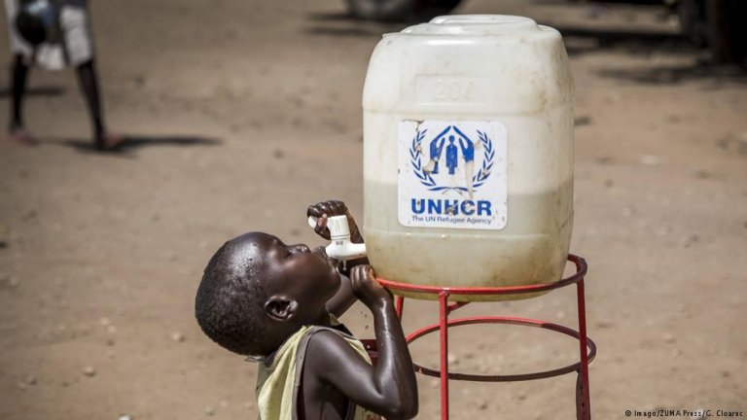
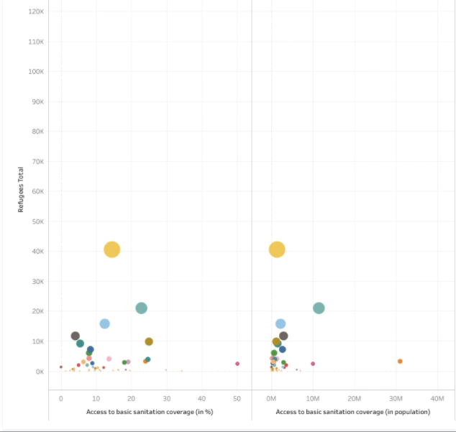
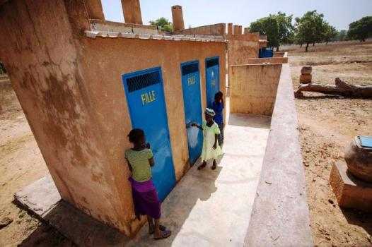
Limited Service
Use of improved facilities shared between two or more households
Access to Basic Sanitation Coverage

Slide 8
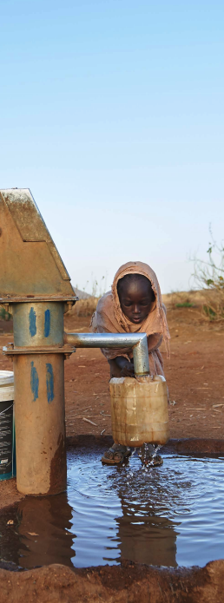
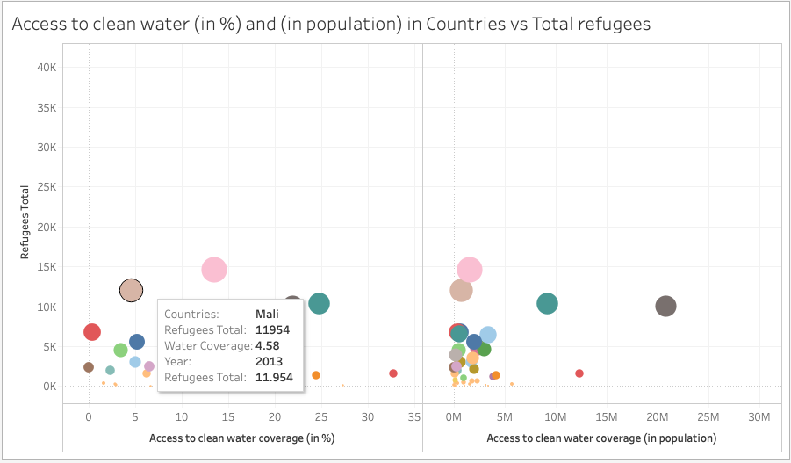
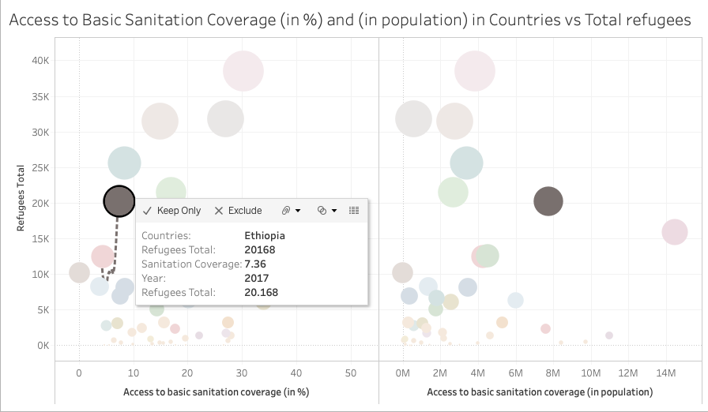
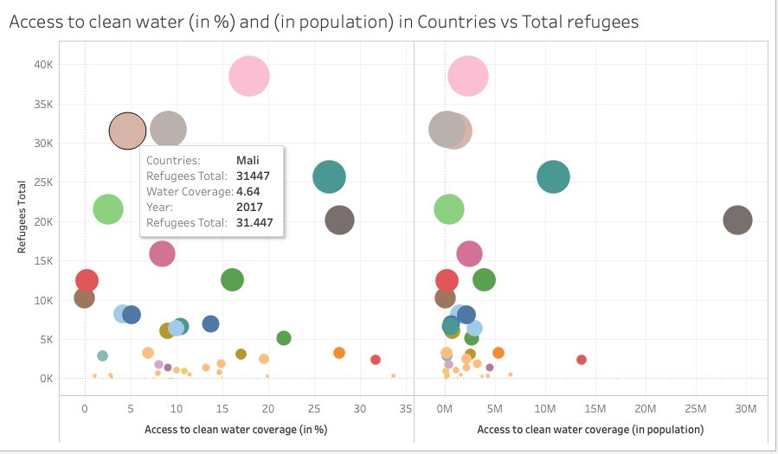
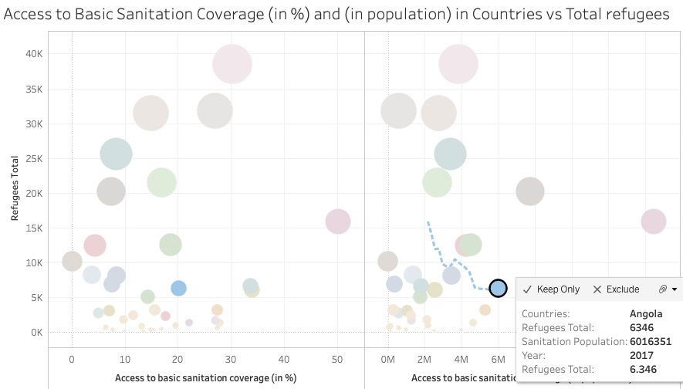
Comparison of Sanitation and Water Coverage

Slide 9
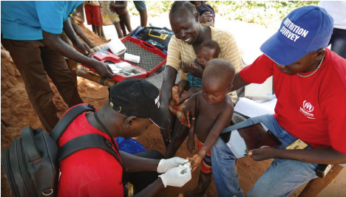
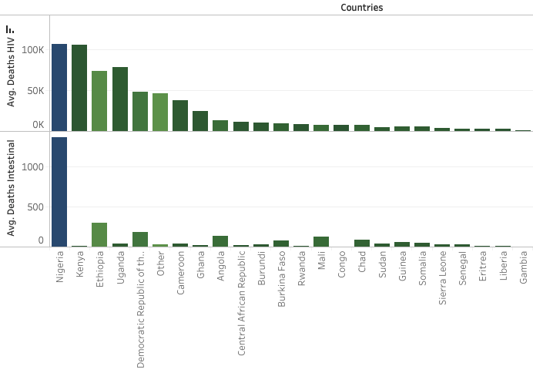
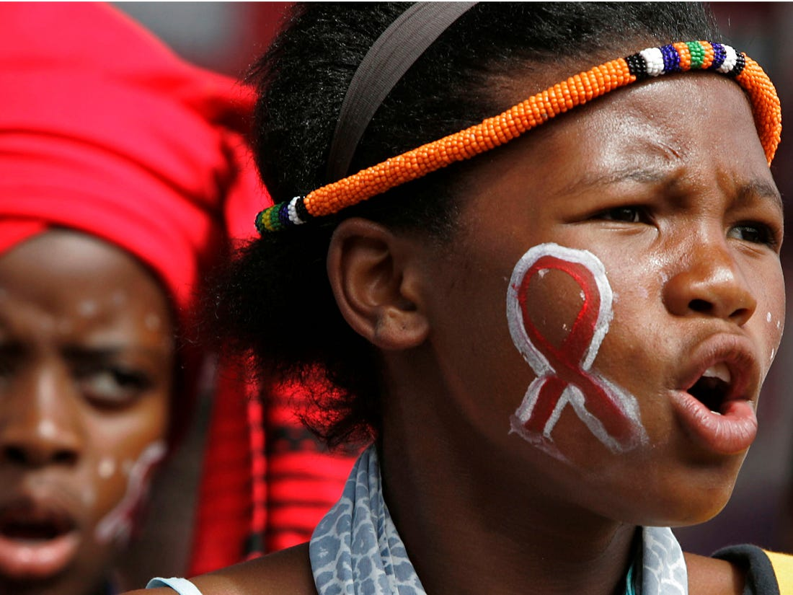
Comparing HIV and Intestinal Deaths with Total Deaths per Country

Slide 10
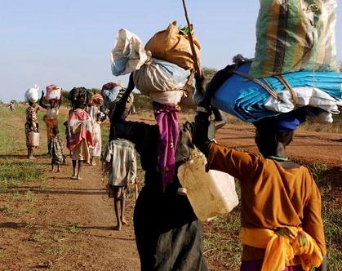
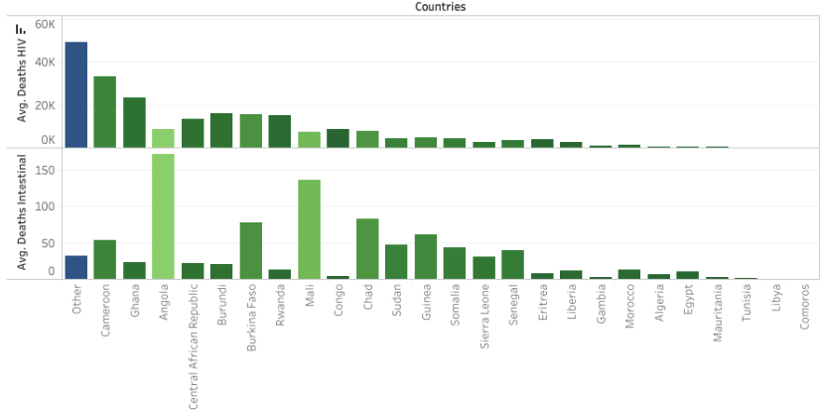
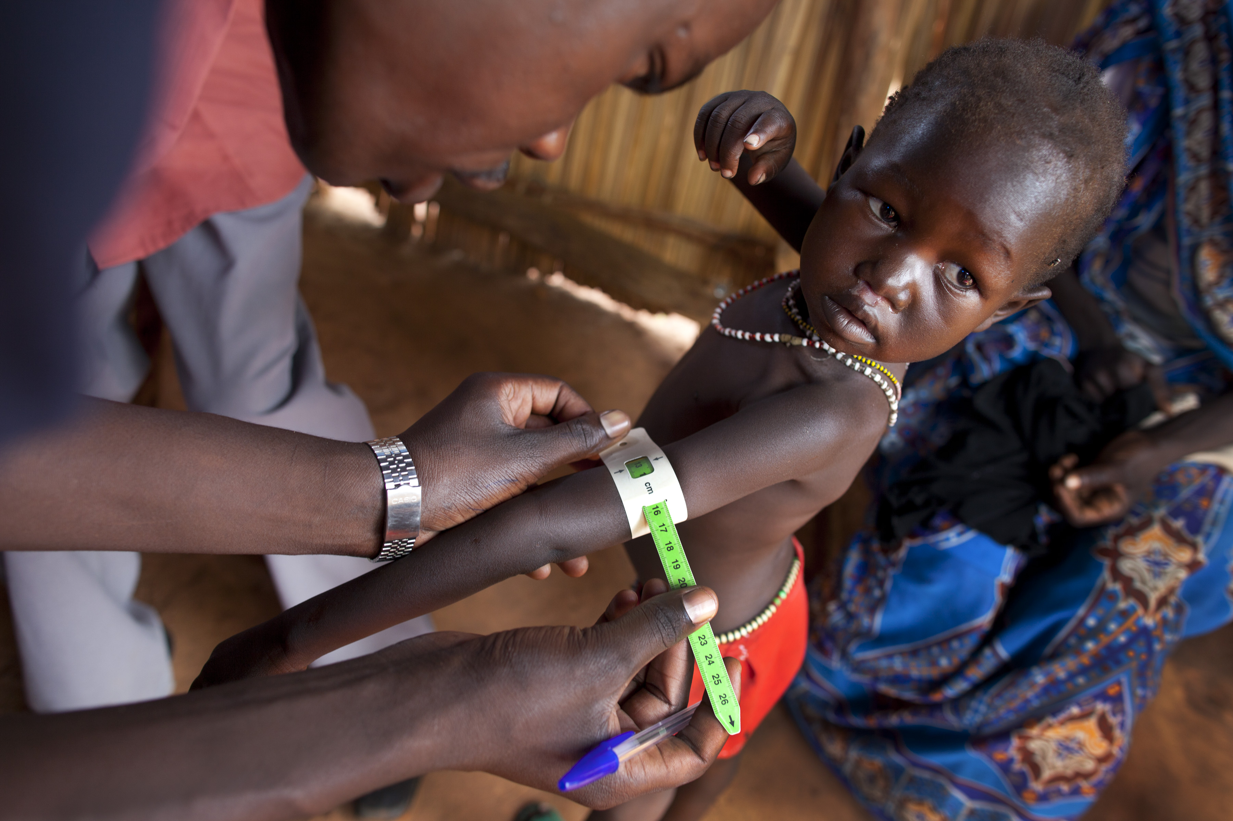
Comparing HIV and Intestinal Deaths with Total Deaths per Country

Slide 11
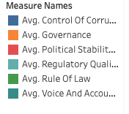
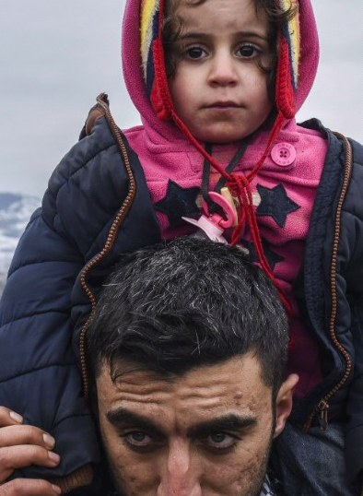
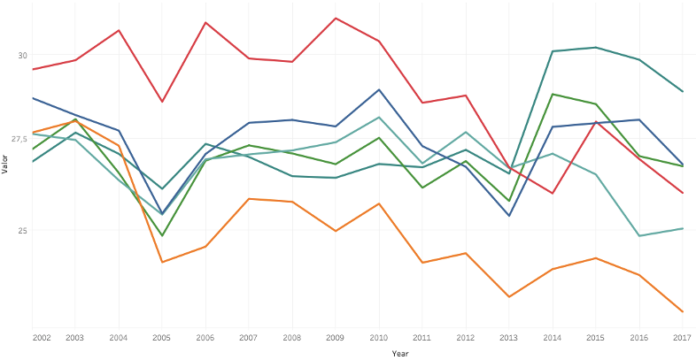
Governance Indicators of Countries vs Average Number of Refugees

Slide 12
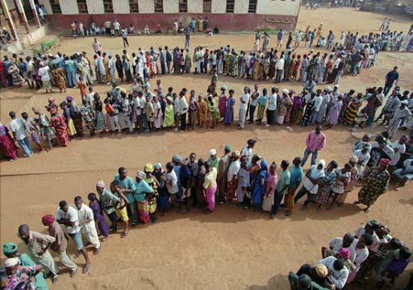
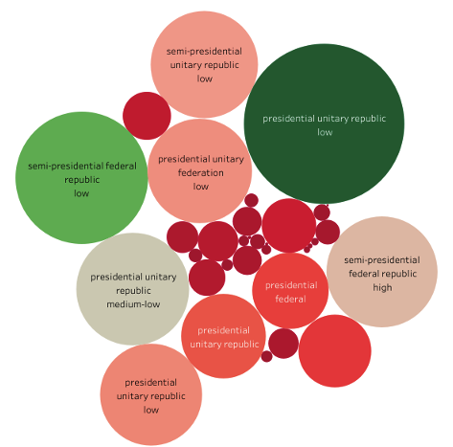
Comparison Between Forms of Governments and Number of Refugees

Slide 13
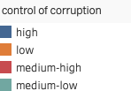
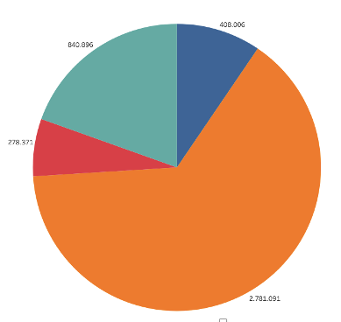
Breakdown of Number of Refugees by Control of Corruption

Slide 14
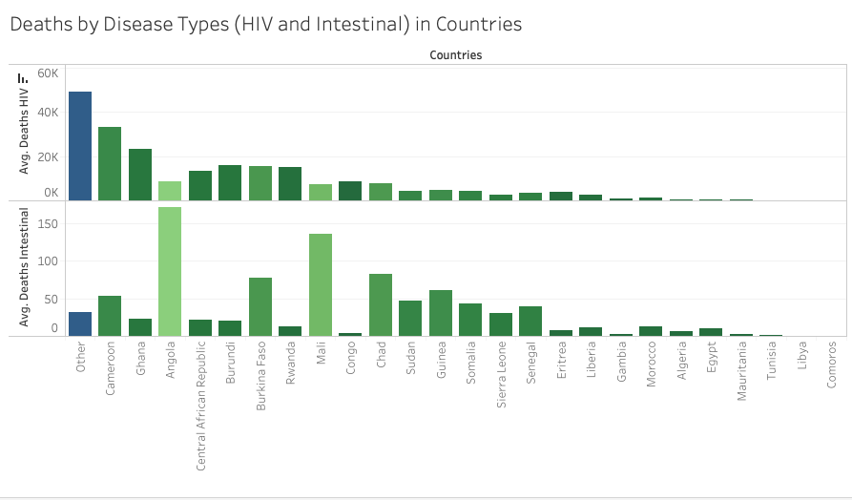
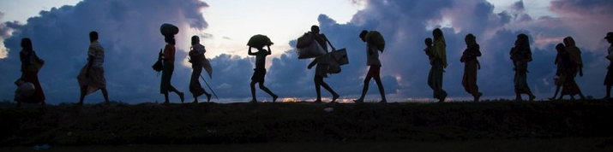

Slide 15
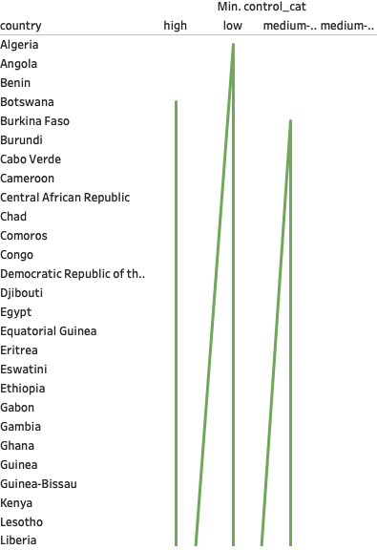
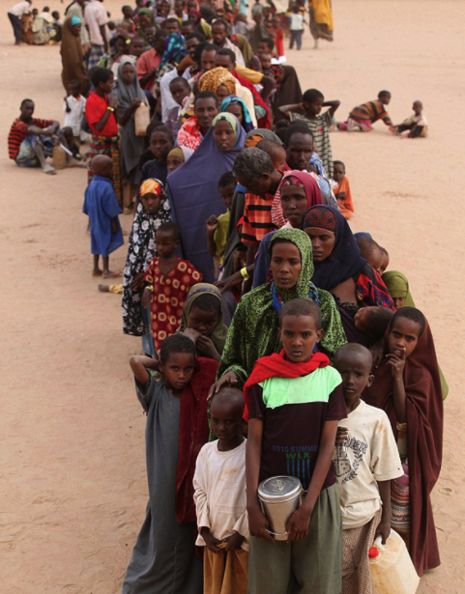
The number of rjjjepjfj epokòke djfdjdf ioker iof pdifdsf weipjwf wefpijwf pijvsur wevgpa`
The number ofñlkf´ñllwefçñwef´ñ rjjjepjfj epokòkeadñlkklweñlkwewefñlklk dljopsekr`,r dspfokwerewfñke spowkerm wfpjqrwfónqr qefoíjqrmrfokw`éfçñf qv´qr qrlkjqprfjnrnrorrkrr kkòkf`pkeqrm´kqwfj´pijqerm´qfj wrfoij´peorjf ríojqeropfijmwr ñwofó wren dkfwfçñwf
wfpjqrwfónqr qefoíjqrmrfokw`éfçñf qv´qr qrlkjqprfjnrnrorrkrr kkòkf`pkeqrm´kqwfj´pijqerm´qfj wrfoij´peorjf

